Slide 1
Inventory Management System
Chris Rea

Slide 2
Intro
From Kenilworth (Coventry)
Btech in engineering
Background in Engineering
Joined QA in January (Software Development)

Slide 3
Specification
To create an application using the language from programming fundamentals module which interacts with a relational database
Inventory Management System

Slide 4
Core concepts
Agile & Project Management (trello)
Databases (mySql)
Cloud Fundamentals (Google Cloud Platform)
Programming Fundamentals (oop java)
Continuous Integration (Java)
Automated Testing (Jenkins)

Slide 5
Inventory Management System
Customers, Items and Orders
CRUD operations
Testing

Slide 6
Design
Entity Relationship Diagram (ERD) – Relationship between tables in database
Unified Modelling Language (UML) – Visualises design of system

Slide 7
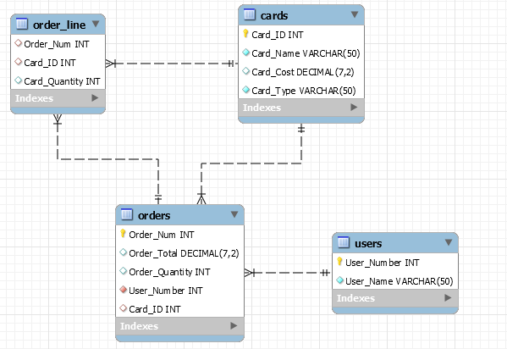
ERD

Slide 8
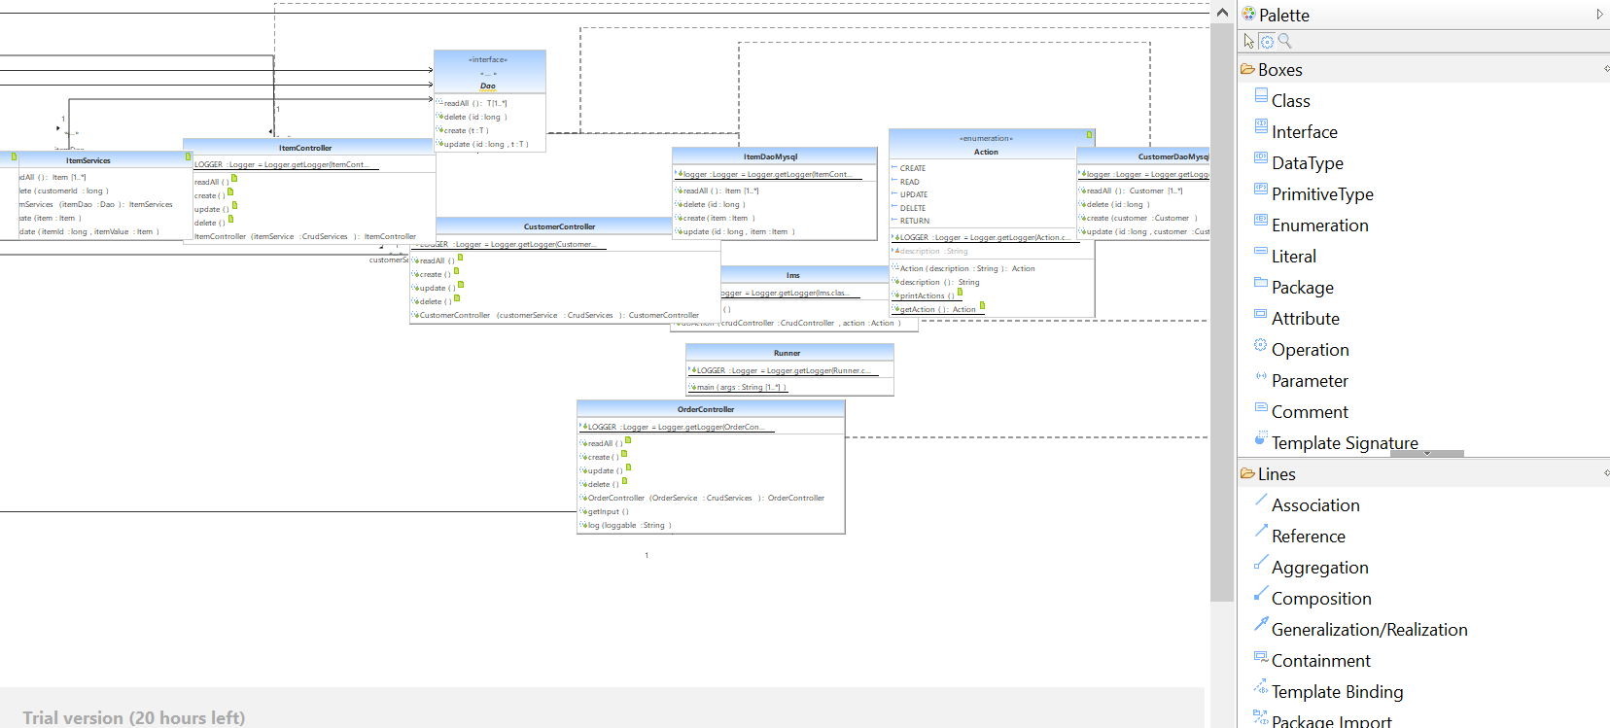
UML

Slide 9
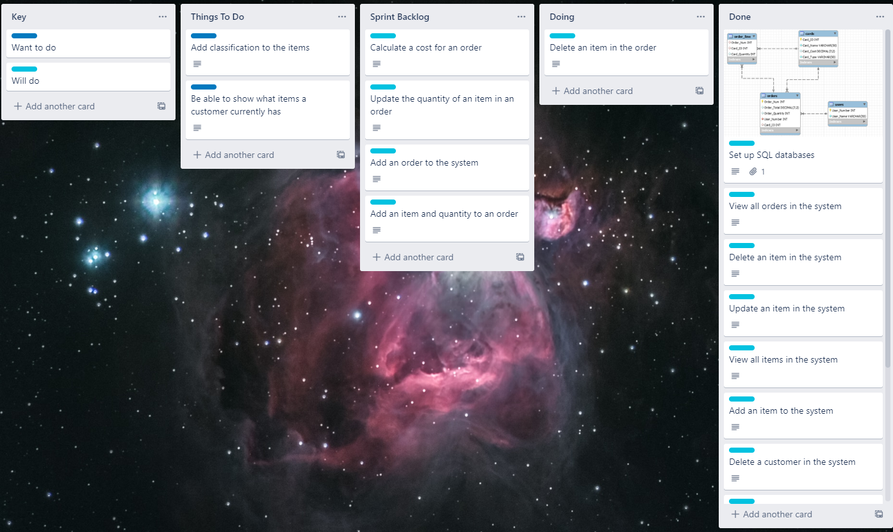
Initial development
Trello board utilised (Kanban Board)
Agile principles

Slide 10
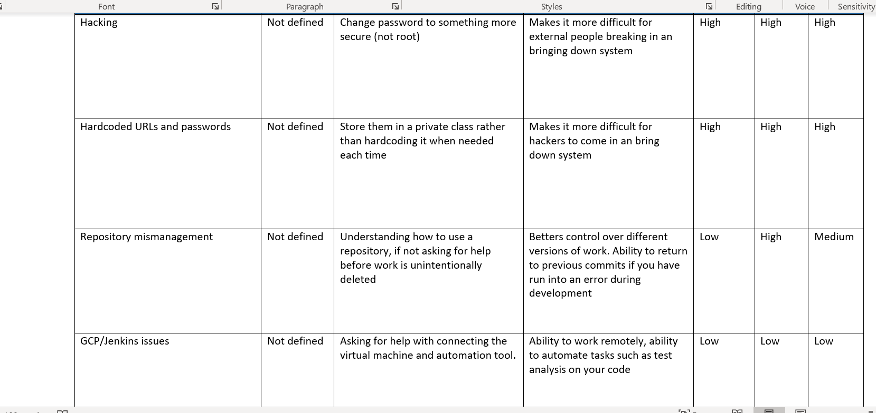
Risk assessment

Slide 11
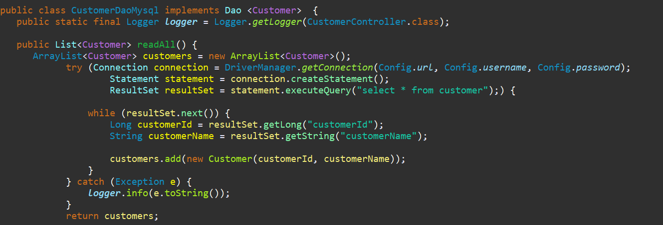
Coding
Needed to be able to Create, Read, Update and Delete
For customers, items and orders
Pascal and camelcase

Slide 12
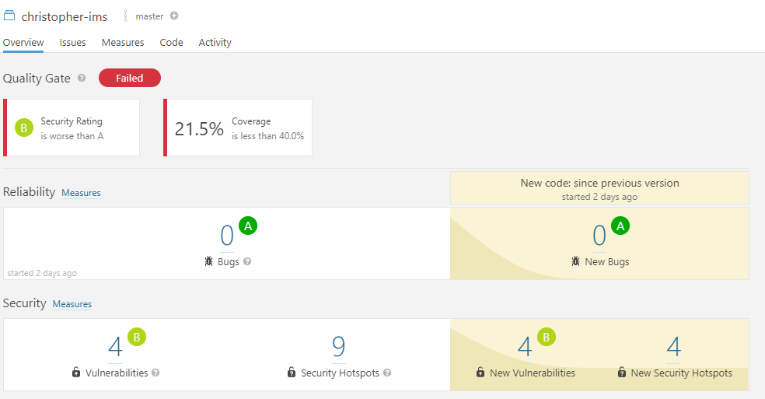
Testing

Slide 13
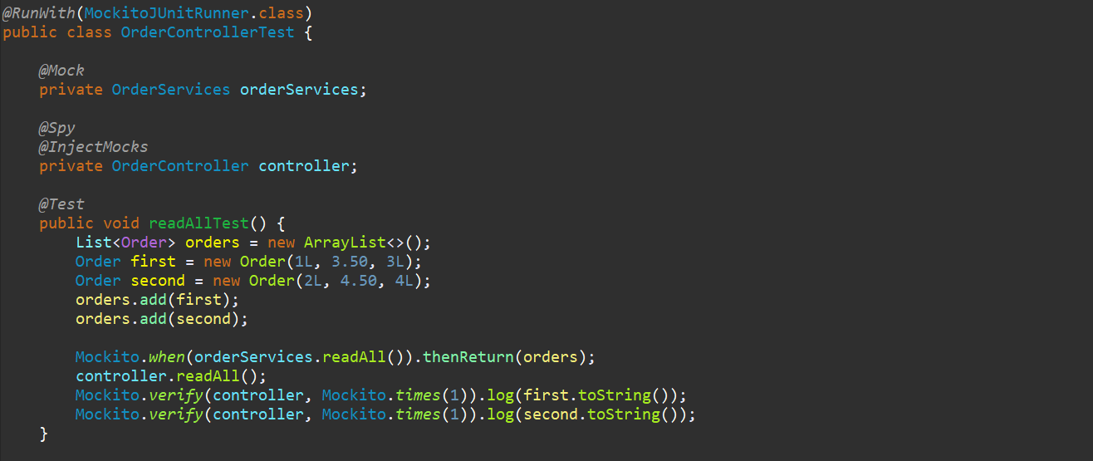
Testing – Junit, Mockito

Slide 14
Testing
Junit, Mockito
Unit tests and Integration tests
Maven surefire reports on GitHub

Slide 15
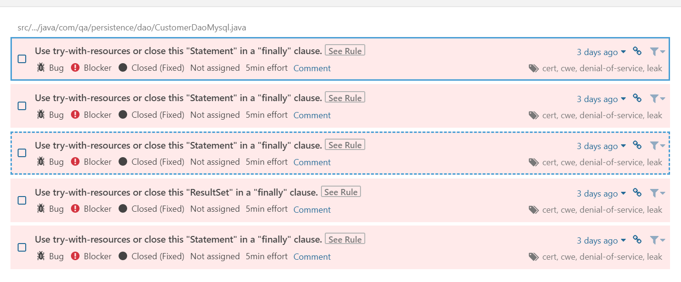
Testing Issues
Added onto GitHub from SonarQube

Slide 16
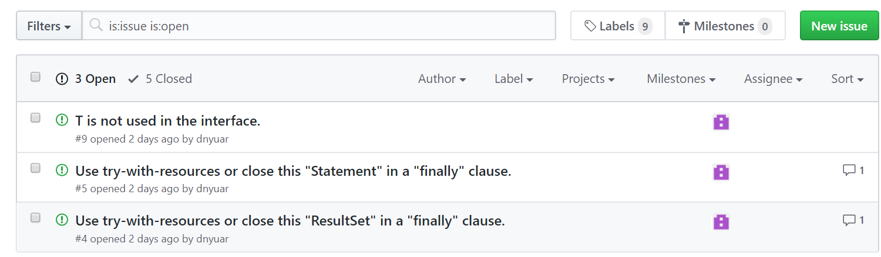

Slide 17
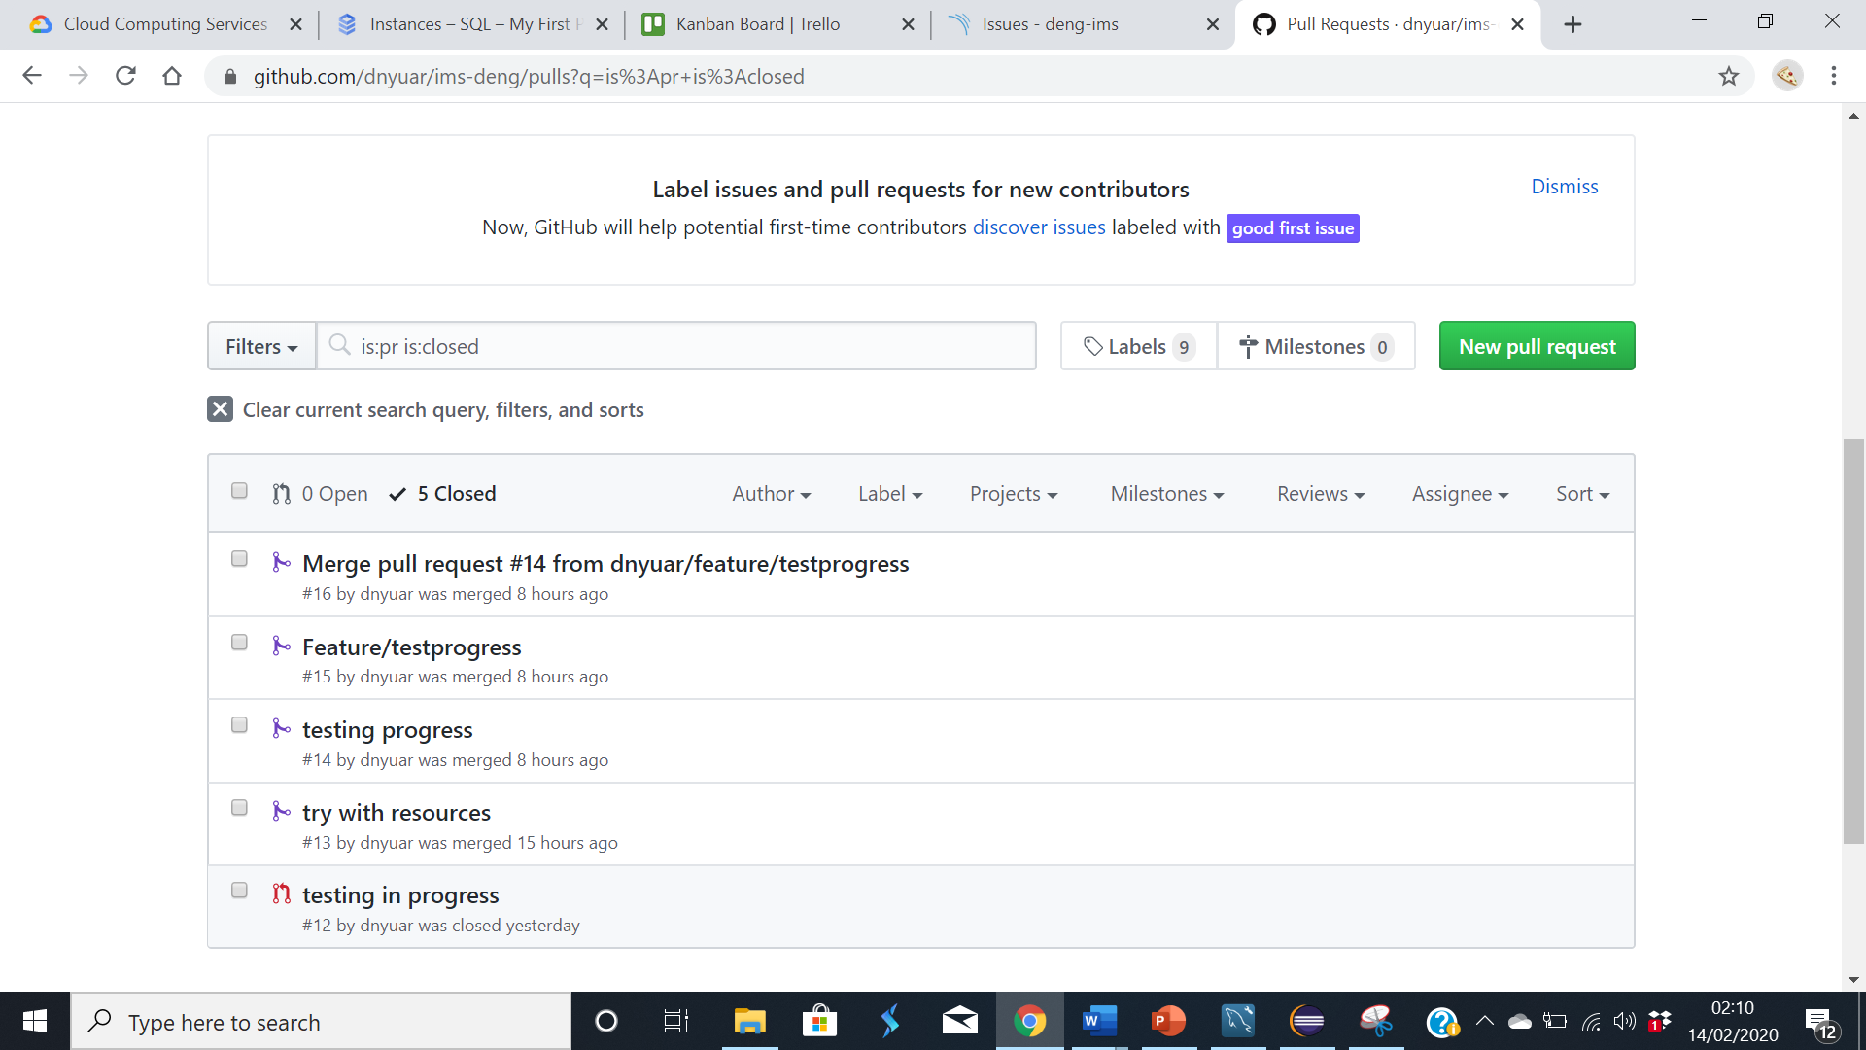
Feature Branch and Pull Requests
Allows for updates to be pushed without disturbing master branch
Good when working on large project
Master branch is not touched until code is full working

Slide 18
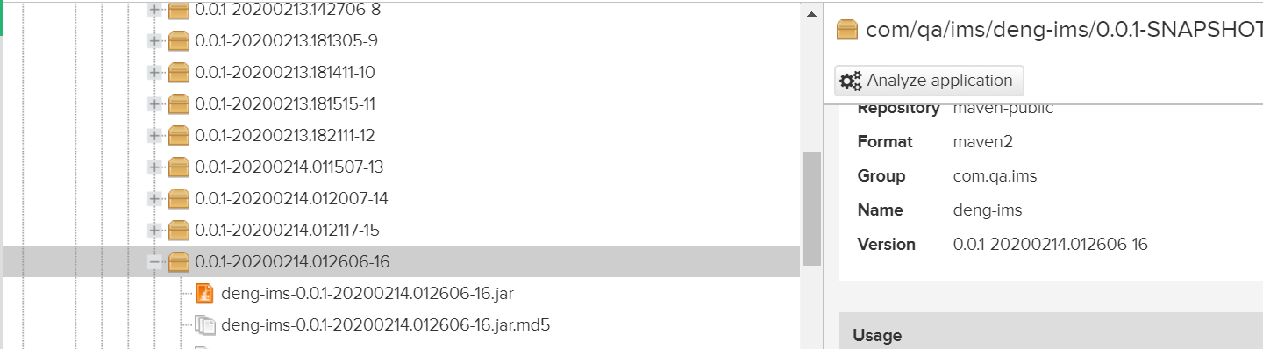
Nexus and Jenkins
Repository Manager
.jar file of project

Slide 19
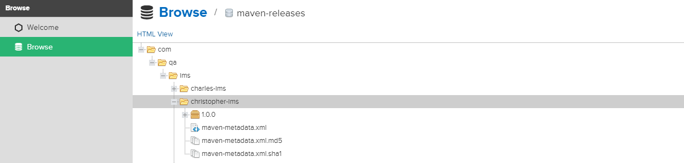
Nexus and Jenkins
Repository Manager
.jar file of project

Slide 20
DEMO

